Slide 1
Music Genre Classification
Minjun Baik, Sean McDonald, Erik Oas

Slide 2
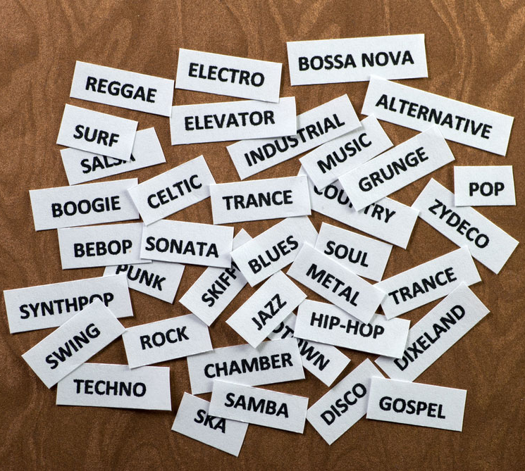
Background
We like music.
Classifying music by their genre is really cool.
This is a perfect machine learning project because there is a lot of data out there and a lot of different features that a classifier can use to differentiate genres

Slide 3
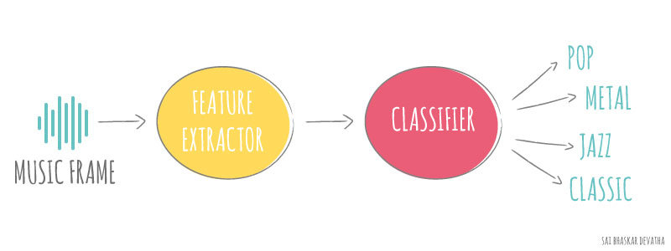
Goal
Classify songs we know into the genre they belong to.
The complexity of songs and our computing power are limiting factors to getting an accuracy value that is usable.

Slide 4
Data
Initial data set taken from ISMIR 2004 - 5th International Conference on Music Information Retrieval. Data was comprised of the following:
320 classical files
115 electronic files
26 jazz/blues files
45 metal/punk files
101 rock/pop files
122 world files

Slide 5

MP3 to WAV Conversion
The python packages implemented needed the files in a WAV format. The audio files were mp3.
At first, we attempted to use python to convert the files, but it took way too long to process a single file.
Solution: VLC
Total conversion took approximately 20 minutes.

Slide 6

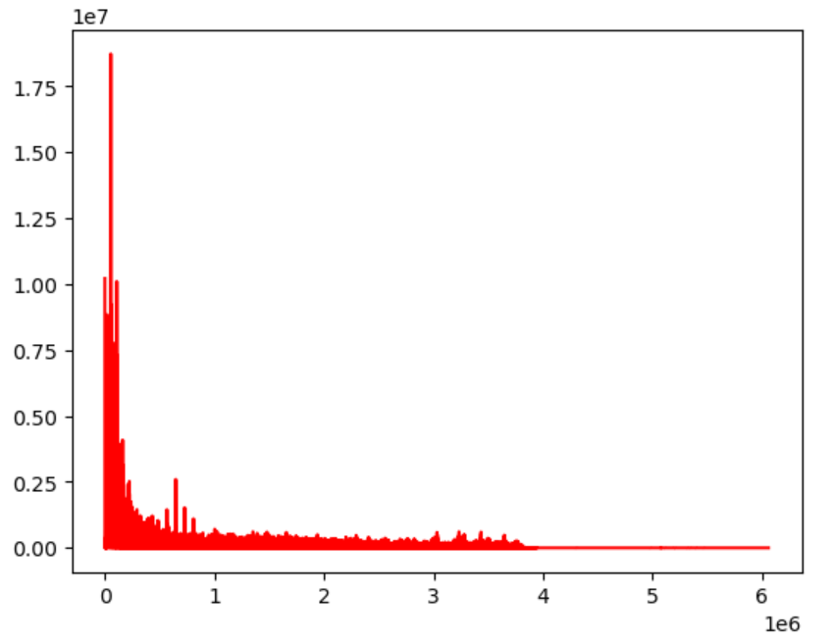
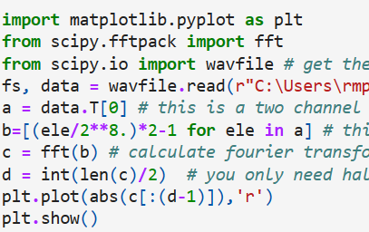
CSV Construction
Next challenge: take WAV files and turn them into useable numbers.
Plan: Take a Fast Fourier Transform (FFT) of each WAV file and put the data into a csv file.

Slide 7
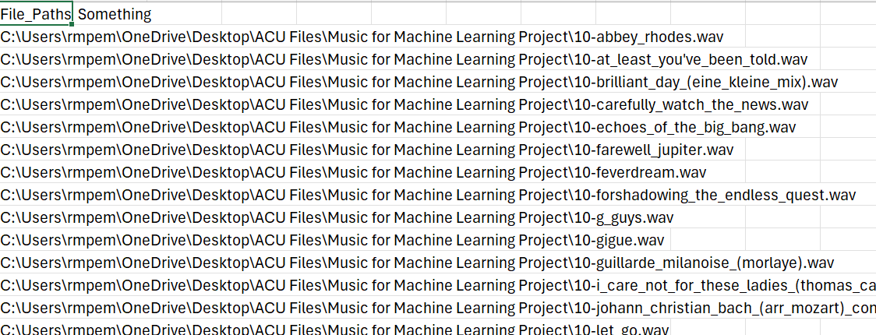
CSV Construction Continued
Problem: It took a long time for a single FFT to compute (about 1 minute)
Solution: remove the normalization step (calculating b on the previous page)
This worked well to speed up the calculation time.
Next Step: Systematize the process.
This involved creating a csv with all the paths listed to the files:

Slide 8
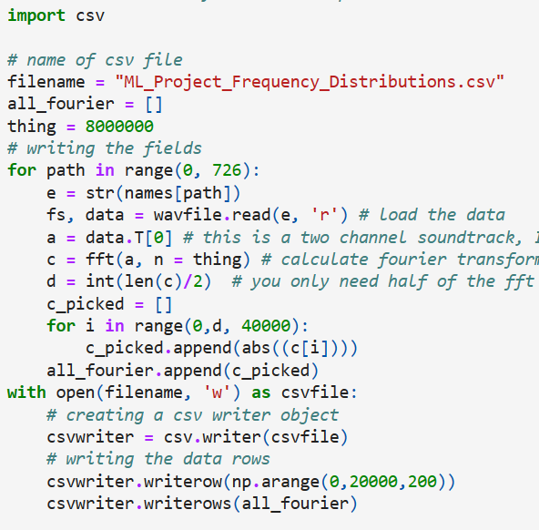
CSV Construction Continued
Next, write a loop to take the FFT of all the audio files and write them to another csv:
Now that the FFTs were obtained, we had to match them to their corresponding genre.
After much pain with excel, this was completed.

Slide 9
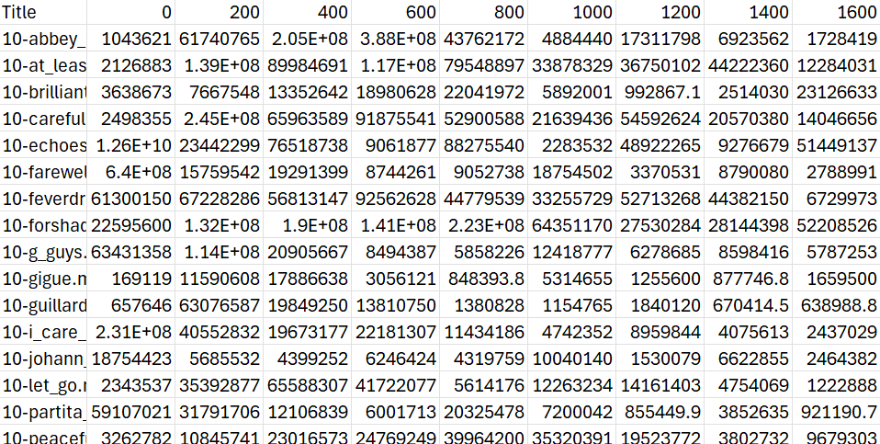
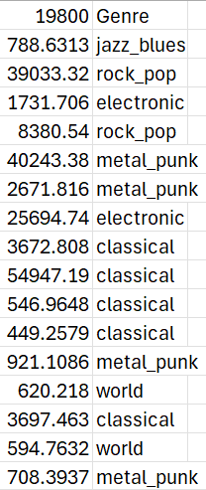
Finished CSV
. . .
.
.
.
.
.
.

Slide 10
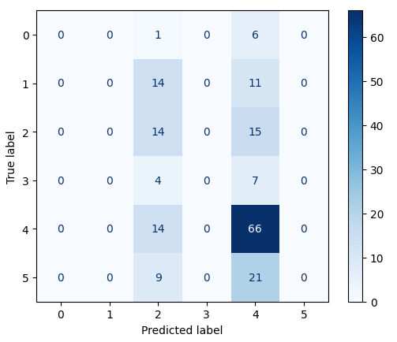
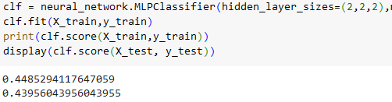
Basic classification
0. Jazz_blues
Rock_pop
Electronic
Metal_punk
Classical
World
We now can start classifying
The score is not too bad. The problem is this
We have a lot more classical songs than anything else so there is more data to go off of

Slide 11
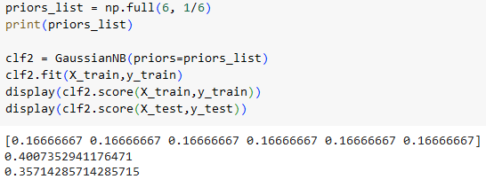
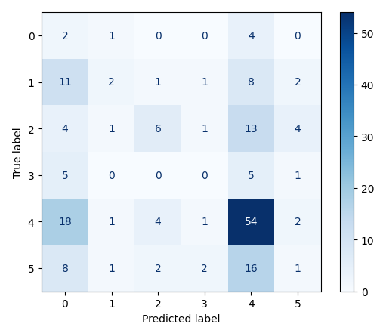
Supposed solution: Use priors
0. Jazz_blues
Rock_pop
Electronic
Metal_punk
Classical
World
Gaussian NB allows the use of priors to properly weight groups that have more samples
And… it didn’t do much

Slide 12
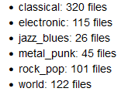
We need more balanced data
We tried a few other classifiers, some of which should have done well with lopsided data sets
LogisticRegressionCV with and without penalty, SVC, and linear SVC
SVC technically did the best with a 46.7% test accuracy, but it still labeled pretty much everything as classical
How about cutting the two genres that barely had any songs:

Slide 13
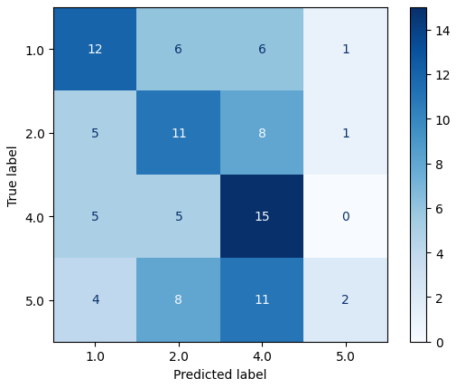
Using the 4 most prevalent genres
0. Jazz_blues
Rock_pop
Electronic
Metal_punk
Classical
World
Separated out 100 songs of each of the 4 genres
Using the same set of classifiers, we got a 40% test accuracy (49% training accuracy) with the SVC classifier.
The accuracy is technically worse than before but we were able to get a more even spread of guesses from our classifier
The classifier doesn’t know what to do with world music (label 5)

Slide 14
New data
We now have better homogeneity but we need to improve our accuracy
We got more data from World Music Music | No Copyright Song & MP3 Free Downloads (pixabay.com). The following were added:
200 new jazz/blues songs
200 new metal/punk songs
100 new electronic songs
100 new pop/rock songs
100 new world songs

Slide 15
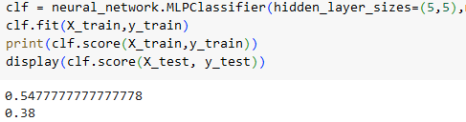
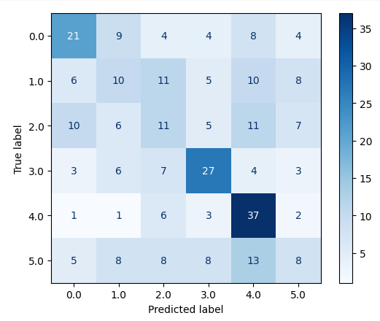
How did this change things?
0. Jazz_blues
Rock_pop
Electronic
Metal_punk
Classical
World
This did help the distribution of scores even with 6 genres
Does best with classical and worst with world
38% is better than 16.6667%

Slide 16
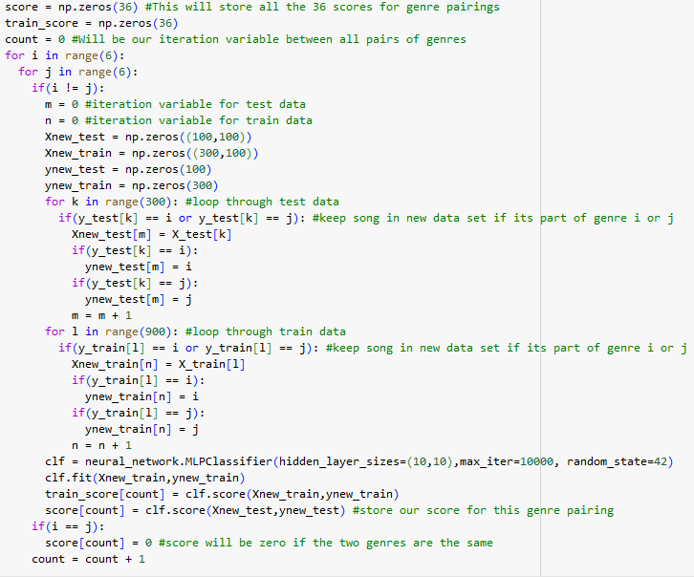
What next?
The 6 genre classification system kind of works but narrowing it down to a 2 genre classifier might be better
Loop through a 2 genre classifier for every combination of 2 genres

Slide 17
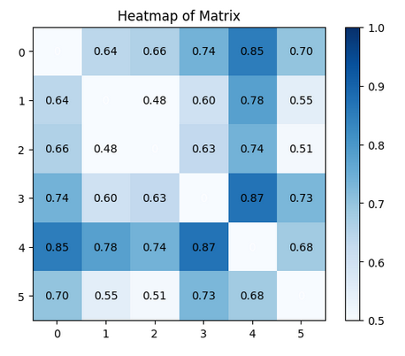
0. Jazz_blues
Rock_pop
Electronic
Metal_punk
Classical
World
This matrix shows the test score for every two genre pair
It’s able to distinguish between metal and classical really well. This makes sense as those genres are very different
Overall good at classifying classical in one on one scenarios
Average accuracy of 68%

Slide 18
Tensorflow VS PyTorch
In general, both are…
Open-source library for ML
Combines various machine learning models
We choose Tensorflow because… harder to implement
Imperative style
Defining computation step-by-step required
Lower-Level API
More control required (more code…)
Too many modules required.
All you need for TF is import tensorflow as tf

Slide 19




Slide 20
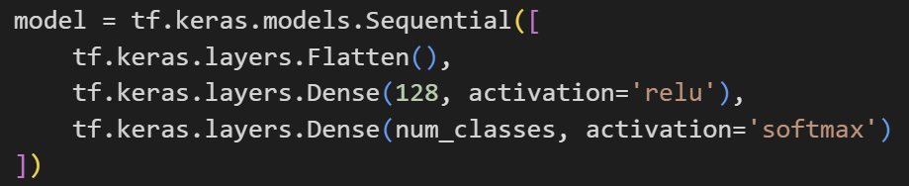
Making model
This is ground model using tf.keras.Sequential
We can add layers
1st problem confronted: Overfitting

Slide 21
Improving models
Layers to play with
CNN
keras.layers.Conv1D()
Flatten
tf.keras.layers.Flatten()
Dense NN layer
tf.keras.layers.Dense(128, activation='relu')
Drop out
tf.keras.layers.Dropout(0.2)
L1 and L2 regularization
tf.keras.layers.Dense(... kernel_regularizer=l1(0.01)) #or l2
Notes:
Flatten
Transform multidimensional tensor into a 1D tensor.
Sequential:
groups a linear stack of layers into a model
Dense:
regular densely-connected NN layer
Dropout
The Dropout layer randomly sets input units to 0 with a frequency of rate at each step during training time,
refers to the practice of disregarding certain nodes in a layer at random during training.
Help to not to overfit
L1 regularization adds the absolute value of the coefficient as a penalty term
L2 adds the squared magnitude of the coefficient as a penalty term

Slide 22
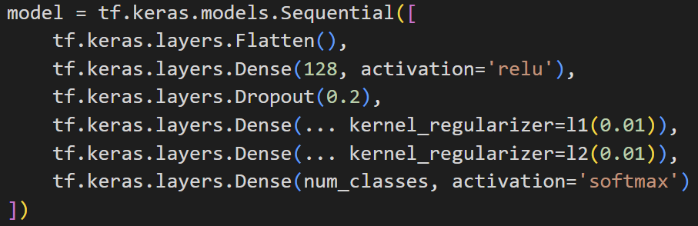
Making models
Example of how to make model

Slide 23
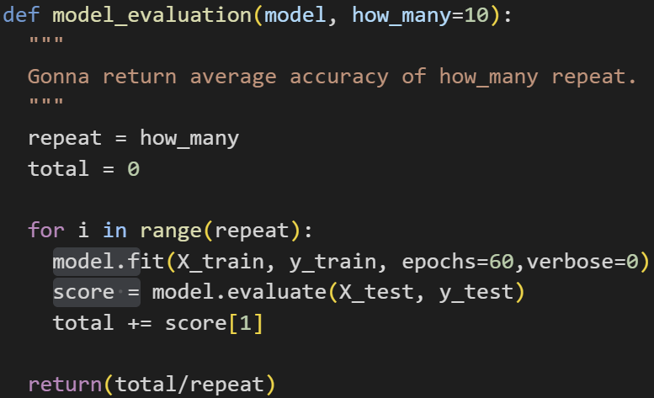
Testing models
We tried to set random state, but …
Averaging ten model evaluation
Repeat experiments and summary statistics
Basically brute force
Add layers and test them
See if it increase the accuracy

Slide 24
Model we ended up with
Simple is the best
No layer benefited our accuracy
With regularization approximately 30~33%
Only adding Flatten layer

Slide 25
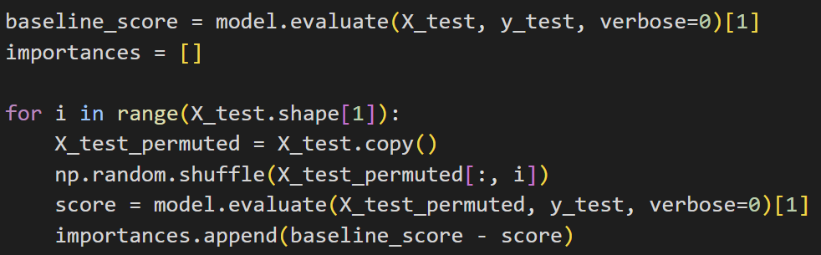
Evaluation of model
Run the model_evaluation with 20 runs
Confusion matrix
Permutation feature importance
What feature contribute the most ?

Slide 26
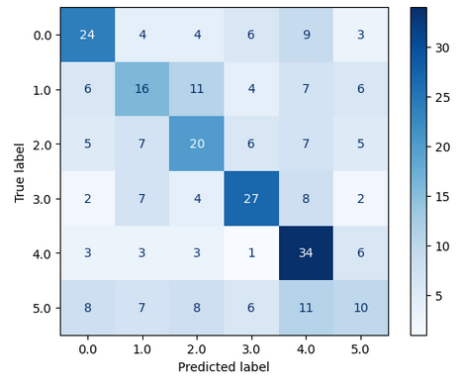
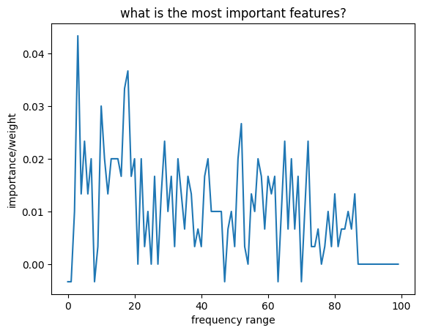
Result of evaluation
0. Jazz_blues
Rock_pop
Electronic
Metal_punk
Classical
World
Achieved average evaluation accuracy 39.8301% (20 runs)
feature

Slide 27

Test Songs
Blue Oyster Cult - Don’t Fear the Reaper
Deftones - Change (In the House of Flies)
Gustav Holst - Jupiter (From The Planets)
Radiohead - Kid A
Starset - Antigravity
Starset - Telescope
Dave Brubeck - Take Five
Rock
Metal
Classical
Electronic
Metal/Electronic
Metal/Electronic
Jazz

Slide 28
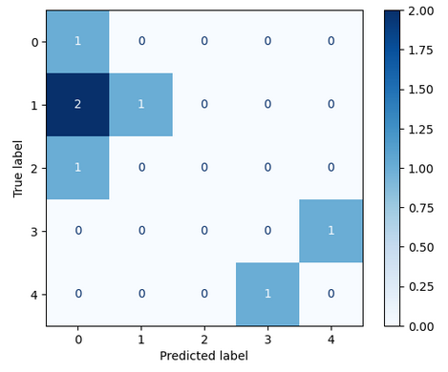
Testing a few of our songs
0. Electronic
Metal_punk
Jazz_blues
Rock_pop
Classical
Using this neural network, we tested a few of our songs
Don’t Fear the Reaper (Rock) was classified as classical
Change In the House of Flies (metal) was classified correctly
Jupiter from the Planet’s symphony (classical) was classified as rock
Kid A (electronic) was classified correctly
Antigravity and Telescope (metal) were classified as electronic. This makes sense though
Take Five (jazz) classified as electronic????

Slide 29
Conclusions
Our only features were frequency values every 200 Hz
Our data set only contained 200 songs for 6 genres
Limited by our computing powers as well
Given this, we did not do too bad
Expanding on this project would require more data, more features, as well as more careful choosing of genres.

